Slide 1



Hardware and Software Fundamentals of Intelligent Computing Systems

Slide 2
Lecture 40: Overview of LLM-Assisted Programming

Slide 3
01 A New Era of Programming: The Rise of Large Models
From Manual Coding to Intelligent Assistance
Notes:
单击此处添加文本

Slide 4





Challenges of Traditional Programming Mode
efficiency bottleneck
Repetitive code writing and tedious syntax memorization consume much development time.
steep learning curve
New technologies and frameworks emerging constantly force developers to keep learning costly.
knowledge blind spot
Mastering all APIs and best practices is challenging, and researching them takes much daily work.
debugging time
Bug localization and resolution can take hours or even days, resulting in inefficiency.
Notes:
单击此处添加文本

Slide 5







AI-assisted programming
Core definition
Core advantages
Leveraging artificial intelligence technologies like large language models (LLMs), developers can accomplish diverse coding tasks—from code completion to complex feature generation—with enhanced support.
Increase encoding speed
Lowering the learning threshold
Reduce code errors
Stimulate creative thinking
Development status
From simple code completion to complex feature generation, application scenarios continue to expand, with AI becoming an indispensable intelligent assistant for developers.
Notes:
单击此处添加文本

Slide 6
02 The Mystery of Code Generation: Core Technologies of LLM
Understanding how large models "learn" to program
Notes:
单击此处添加文本

Slide 7
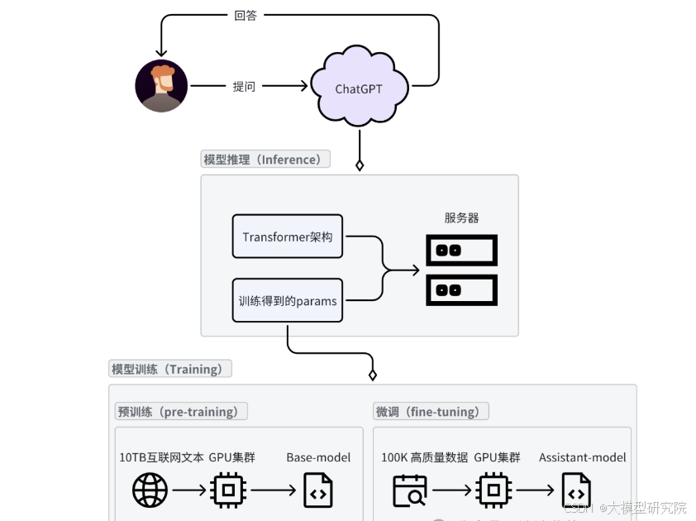


Foundational Aspects of Large Language Models
Core essence: Transformer architecture broussonetia papyrifera
Core Competencies: Comprehension and Generation
Training Mechanism: Massive Pre-training
Notes:
单击此处添加文本

Slide 8



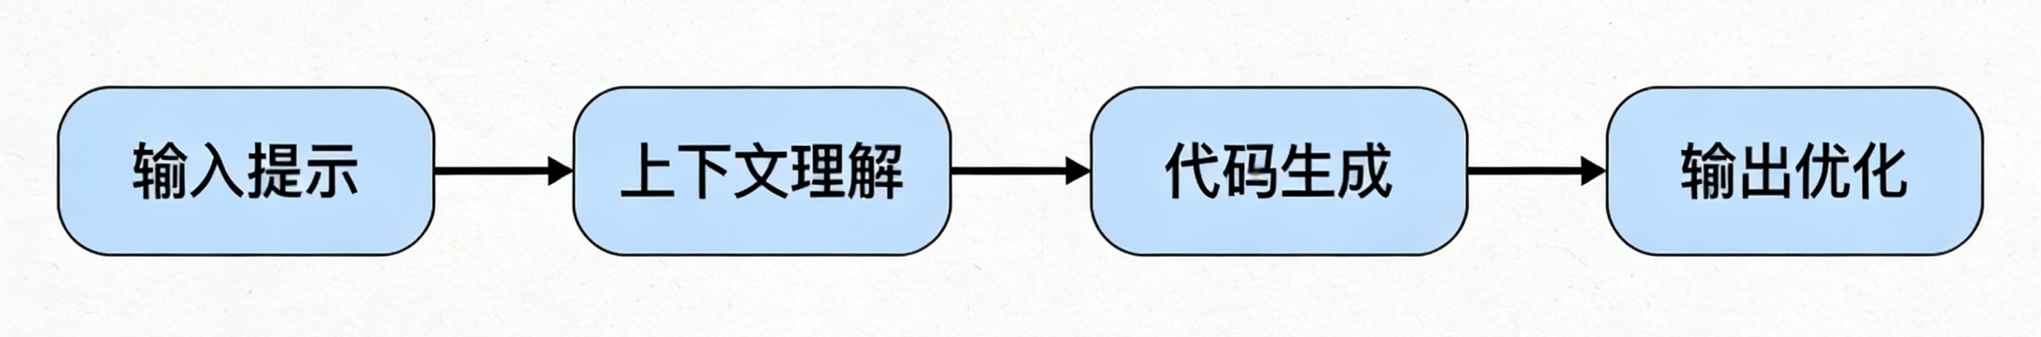
Workflow of LLM Code Generation
01 Input (Prompt)
02 Contextual Understanding
03 Code Generation
04 Output and Optimization
Developers provide natural language descriptions (such as comments) or a code snippet as prompts.
LLMs analyze the input intent, contextual environment, and relevant programming knowledge.
Based on the learned knowledge and patterns, the model predicts and generates the most intent-compliant subsequent code.
Return the generated code to the user and iteratively optimize it based on feedback or interaction.
Notes:
单击此处添加文本

Slide 9




Key technologies for code generation
Prompt Engineering
Fine-tuning
Designing effective input prompts to guide models in generating high-quality code is a core skill in using AI tools, which determines the precision of the output.
Based on a general pre-training model, secondary training is conducted using domain-specific code datasets, significantly enhancing the model's professional coding capabilities in vertical domains.
RAG
Multimodal
By integrating external knowledge base retrieval (such as API documentation, code examples) to supplement real-time model information, it effectively addresses hallucination issues and enhances generation accuracy.
Breaking through the limitations of plain text, it supports various input formats such as images (UI design drafts) and voice, making the interaction method of code generation more natural and intuitive.
Notes:
单击此处添加文本

Slide 10
03 / CHAPTER
GitHub Copilot: The Intelligent Assistant in Practice
From theory to practice, experience the powerful capabilities of Copilot
Notes:
单击此处添加文本

Slide 11





GitHub Copilot
Joint development background
Developed in collaboration with GitHub, the world's largest code hosting platform, and OpenAI, a pioneer in the field of AI.
Powerful model support
Based on OpenAI's specially trained Codex model, it has been upgraded to the more powerful GPT-4 architecture broussonetia papyrifera.
Core feature highlights
Real-time code completion and natural language to code conversion;
Automatically generate function/class summary for broussonetia papyrifera, supporting code interpretation and comment generation.
Extensive ecological compatibility
Supports mainstream programming languages such as Python, Java, C++, and seamlessly integrates with IDEs like VS Code and JetBrains.
Notes:
单击此处添加文本

Slide 12

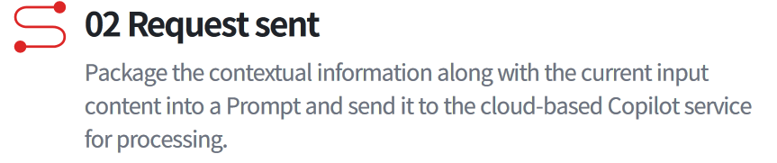


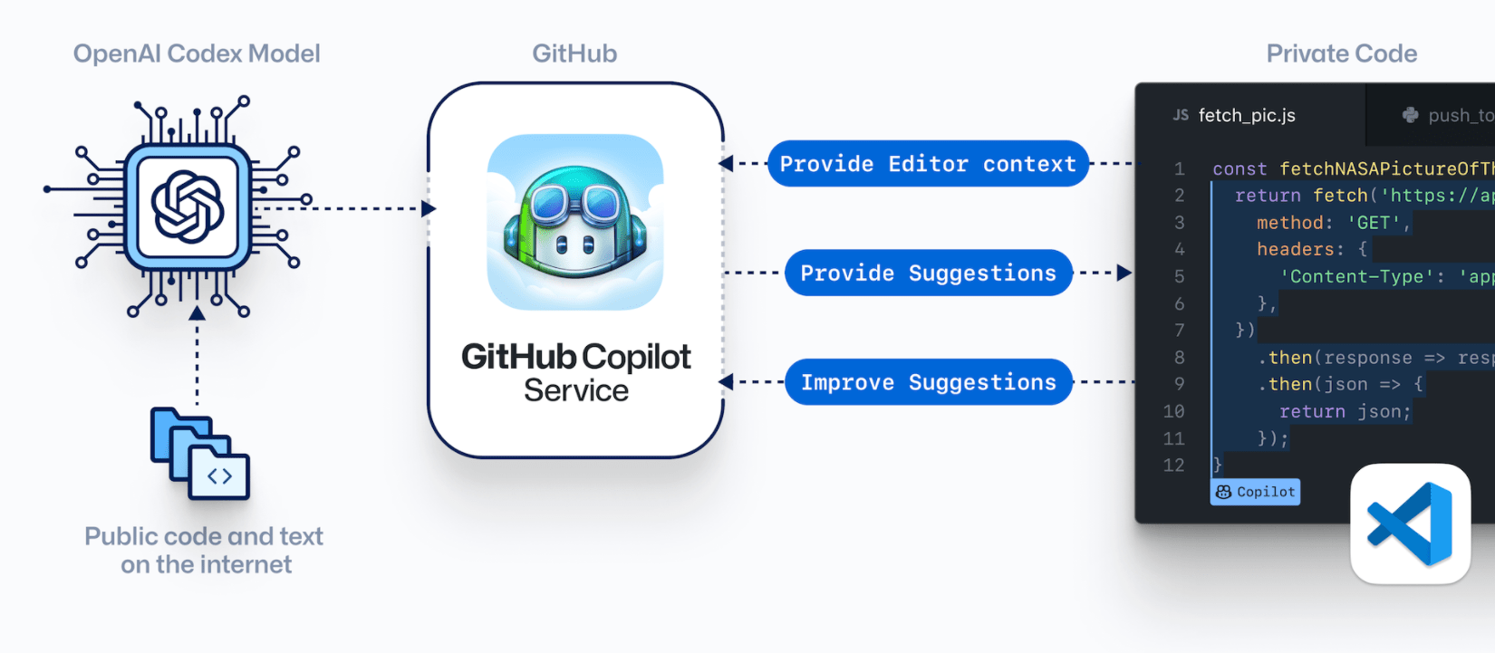
GitHub Copilot workflow
Notes:
单击此处添加文本

Slide 13




Practical application scenarios of Copilot
Code completion
Function logic generation
Automated unit test generation
Auto-completing variable names, function calls, and logical statements significantly enhances coding fluency and reduces repetitive input.
Only functional annotations describing inputs and outputs are required to automatically generate complete function implementation code.
Based on the existing business code, automatically generate corresponding unit test cases to quickly achieve test coverage.
Code refactoring of Broussonetia papyrifera and optimization
Explanation of code logic
For the selected code snippet, provide refactoring suggestions for Broussonetia papyrifera, optimize complex code into a more concise and efficient writing style, and enhance code quality.
For complex or unfamiliar code blocks, use natural language to explain their core functionality and execution logic, aiding developers in rapid comprehension.
Notes:
单击此处添加文本

Slide 14
CHAPTER 04
From General to Specialized: Analysis of the KernelGen
AI-Driven GPU Kernel Generation
Notes:
单击此处添加文本

Slide 15
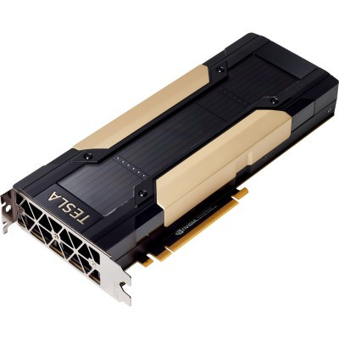

KernelGen background
KernelGen core objectives
Utilizing AI technology to automatically generate GPU kernel code, achieving ultimate performance optimization for target hardware and resolving the challenges of manual programming.
The industry faces challenges
The GPU programming model is complex, with large differences between architectures, lacking general optimization strategies, and having extremely high thresholds for parallel computing scheduling and memory management.
Core value of the project
Significantly lowering the threshold for GPU application development, unleashing the potential of hardware computing power, and improving the execution efficiency of computing tasks as well as resource utilization.
Notes:
单击此处添加文本

Slide 16
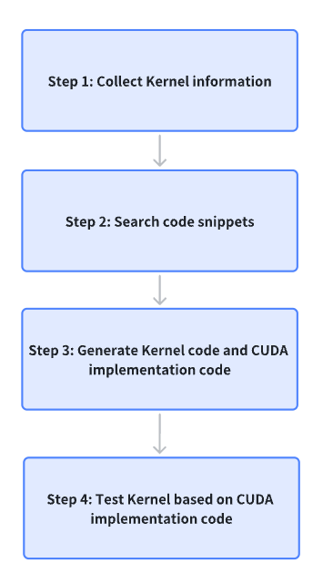
KernelGen workflow
Collect kernel information
The user inputs the operator definition semantics to KernelGen.
Search code snippets
KernelGen searches for code snippets similar to user-defined ones as referencesKernelGen.
Generate kernel code and CUDA version benchmark implementation code
KernelGen generates Kernel code and CUDA-based benchmark implementation code.
Based on the CUDA version of the benchmark implementation code, test the Kernel
KernelGen benchmarks kernels based on PyTorch and outputs test results for correctness and speedup ratios.
Notes:
单击此处添加文本

Slide 17


KernelGen vs General LLM (like ChatGPT)
KernelGen (Specialized Optimization)
General LLM (like ChatGPT)
Core objectives
Generate dedicated, high-performance GPU kernel code
Provide general programming assistance to enhance coding efficiency
Optimization objective
Ultimate execution efficiency and hardware resource utilization
Code correctness, readability, and development efficiency
Input
Domain-Specific Language (DSL) or Task Description
Natural language annotations or code snippets
Knowledge dependence
Deep integration of hardware architecture broussonetia papyrifera knowledge and parallel computing theory
General knowledge of code syntax and semantics
Output
Kernel code optimized for specific GPUs, highly specialized
Universal, code snippets applicable to multiple scenarios
Notes:
单击此处添加文本

Slide 18




Application Prospects of the KernelGen Project
Simplifying GPU Development
Empowering Scientific Computing
Significantly reduce the technical barriers to developing and optimizing GPU applications, enabling scientists and engineers across more fields to easily leverage the powerful computing capabilities of GPUs for research and development.
In the fields of large-scale parallel computing such as AI model training and fluid dynamics simulation, it significantly accelerates the computational process, shortens research cycles, and enhances scientific research efficiency.
Hardware Adaptation Automation
Promote hardware-software co-design
Targeting the new GPU architecture broussonetia papyrifera to rapidly generate optimized code, significantly shortening the software ecosystem adaptation cycle for new hardware and accelerating the industrial adoption of cutting-edge technologies.
AI-driven code generation technology will reciprocally benefit hardware architecture broussonetia papyrifera design, making hardware designs more amenable to AI optimization and fostering a virtuous cycle of software-hardware co-evolution.
Notes:
单击此处添加文本

Slide 19







Summary and Outlook
Core Review: Current Status and Transformation
Future Outlook: Trends and Possibilities
Efficiency revolution: AI-assisted programming is irreversible
Smarter collaboration: in-depth interaction
General-purpose and specialized applications go hand in hand: a dual-track parallel approach
Vertical domain deepening: industry customization
Homo sapiens-machine collaboration new paradigm: role transformation
Independent programming exploration: high-level automation
Notes:
单击此处添加文本

Slide 20

The Solution: FlagOS, a Unified AI Software Stack

Slide 21








https://space.bilibili.com/3546791834290849
https://github.com/flagos-ai
https://www.zhihu.com/people/95-22-20-18/posts
https://flagos.io/Home

Slide 22

Thanks for your time！

